Slide 1

DS551 Fall 25 - Epidemic Engine
(Team 07)
Team Members:
Joshua Lee
Pranshu Swaroop
Samritha Aadhi Ravikumar
Shravani Maskar
Date: 12/16/2025
Notes:
"Hello, we're Team 7. Our team includes Joshua Lee, Pranshu Swaroop, Samritha, Shravani. We built a cloud-native epidemic monitoring platform using NiFi, Kafka, Spark, and OpenShift. Here's what we accomplished in Phase 3."

Slide 2
System Architecture
raw JSON
route by event_type
Events Generator
NiFi
Kafka
(publish)
Phase 1
(Symptom | Clinical | Environmental)
Spark Analytics
Postgres
Phase 2
Analytics
query/read
Features
Jupyter
Grafana
Slack alerts(via Webhook) + Logs
Pod Logs
(Notebooks)
Dashboard
Phase 3
Basic & Advanced Alerting
Anomaly Detection & Outbreak Prediction
Visualization
ML Model Comparison
Testing & Data Quality Monitoring
Notes:
Our pipeline has three main stages. We ingest raw Kafka events with NiFi, route them by event_type, and republish them for Spark analytics. Spark runs multiple analytics which is then posted to postgres for furter feature implementation. This including alerting (slack webhook), anomaly detection, and outbreak prediction (random forest), and writes results to Postgres. We then use Jupyter on top of Postgres for visualization and model comparison, including extra credit ML. Lastly, Grafana monitors data quality, and anomaly strength over time to detect instability and drift.

Slide 3
Features Implemented
Category | Feature | Status | Team Member(s) | Points
Phase 1 | Data Ingestion | ✅ Completed | Joshua | 60 pts
Phase 2 | Analytics & Storage | ✅ Completed | Shravani | 40 pts
Phase 3 | Integration & Features
Category A | Basic Alerting | ✅ Working | Samritha | 20 pts
 | Advanced Alerting | ✅ Working |  | 30 pts
Category B | Anomaly Detection | ✅ Working | Samritha | 25 pts
 | Outbreak Prediction | ✅ Working |  | 35 pts
Category C | Visualisation | ✅ Completed | Samritha | 15 pts
Category D | Comprehensive Testing Suite | ✅ Completed | Pranshu | 20 pts
 | Data Quality Monitoring | ✅ Completed |  | 25 pts
Extra Credit | Grafana Dashboard | ✅ Completed | Pranshu | 15–30 pts
 | ML Model Comparison | ✅ Completed | Pranshu & Joshua | 15–35 pts
Notes:
Our first feature that we implemented was the entirety of phase 1. We ensured that the flow was using processors such as consumekafka, evaluatejsonpath, routeonattribute (event_type), updaterecord (data enrichment), and publish kafka. We ensured this feature was up and running with no errors by checking the data provenance.
Within our Jupyter Notebook we connected with postgres to grab our temporal data which showed patterns of dates and patients. We did a baseline model which was the rolling average with a window of 5 and trained 2 models which were linear regression and gradient boosting using sklearn. Our metrics were accuracy, RMSE, and MAE.

Slide 4
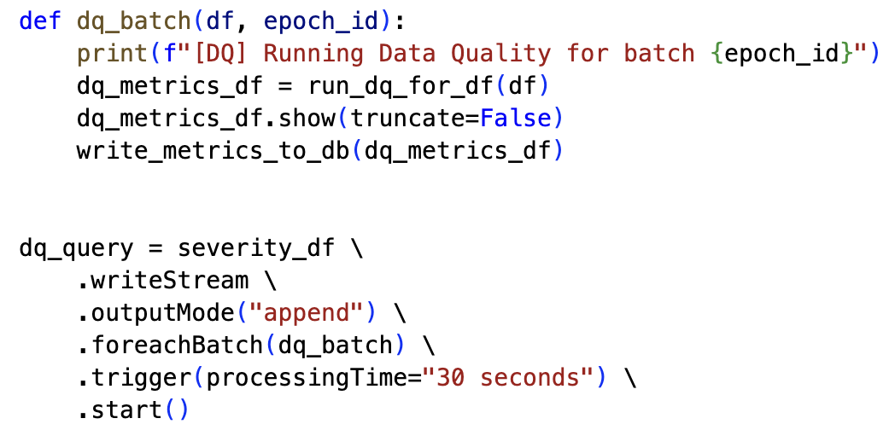
Technical Deep-Dive
Micro-batch Data Quality Monitoring (Spark foreachbatch → Postgres)
Isolated batch-level validation function
Applies validation rules & aggregates failures
Persists data quality metrics to Postgres
Runs data quality validation once per micro-batch
Continuous monitoring with fixed reporting interval

Slide 5
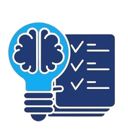
Lessons Learned
Challenges: Debugging across pods needed oc logs.
If starting over: Freeze schema + topic contracts early (event_type + required fields).
Given more time: Add validation, error handling, and lag + DB write metrics.
Recommendation: Replay + trace_id for debuggable, resilient streaming.
Notes:
Key Challenges
Debugging was difficult because data flowed across multiple pods
Required checking pod logs (oc logs) and manually tracing data from Kafka topics to database rows
What We’d Do Differently
Lock down schema and topic contracts early
Clearly define required fields (e.g., event_type) to avoid breaking downstream consumers
With More Time
Improve reliability and observability
Add stronger validation, better error handling, and monitoring for consumer lag and database writes
Recommendation Going Forward
Enable replayability and add a trace_id so every event can be followed end-to-end

Slide 6

Gen AI
Used for learning/debugging: Clarified Spark streaming concepts and helped interpret error logs; we validated by rerunning in OpenShift.
Most helpful: Converting log messages into a checklist (config, schema, permissions, resources).
Limits: Couldn’t know our cluster/YAML/quota setup—final fixes came from oc describe, pod logs, and config edits.

Slide 7
Thank You! Q&A

